Slide 1


Office of Student Services
Shelley Genzer
Senior Student Program Coordinator
Paije Fauser
Admissions and Recruitment Manager
Joey Geresi
Assistant Dean for Student Services
Chad Hobbs
Student Recruiter and Career Development Coordinator

Slide 2

Office of Student Services-OKC
College of Public Health Building,
Suite 165
Call: 405-271-2308
E-mail: hcoph@ouhsc.edu
Office Hours:
8:00 am – 5:00 pm
Monday - Friday

Slide 3
Included in your folder …
Orientation agenda
Academic calendar
Health insurance/waiver requirements
Enrollment form
New student checklist
Bursar information
Class Schedule (OKC only)
Other FAQs and Links

Slide 4
Services Provided
Enrollment/ Advisement
Monitor academic progress
Class scheduling
Employment/ Internship/ Funding Information
Practicum Placement/ Advisement
Graduation/ Commencement Ceremony

Slide 5

HIPAA Requirement
The University is required to be compliant with the HIPAA Privacy and Security Regulations. The regulations establish national standards regarding uses and disclosures of protected health information. All faculty, staff and students are required to receive annual HIPAA training.
Training can be found at: https://onpoint.ou.edu/.
Additional information and training instructions are available at: http://ouhsc.edu/hipaa/.

Slide 6
Student Health Insurance
University of Oklahoma Regent’s Policy requires students enrolled at the the Health Sciences Center to have health insurance prior to the start of their academic program and coverage must be maintained as long as the student is enrolled at HSC. Students may participate in either the student approved health insurance policy or show proof of insurance coverage (comparable to the student policy offered through the University). http://students.ouhsc.edu/HealthInsurance.aspx
Instructions to purchase or request to submit waiver health insurance information was sent to you via email and is included in the folder.
Waivers must be submitted each semester.

Slide 7
Sexual Misconduct Awareness Training
All students enrolled in undergraduate, graduate, or professional programs are required to take the online sexual misconduct awareness training which is located online.
Training can be found at: https://onpoint.ou.edu/
Username and Password: Standard HSC login (same one used for email)
Help Contacts: Please contact the IT Service/Help Desk staff
If you do not complete this training a hold will be placed on your enrollment for the following semester. The hold will be lifted when you complete the training.

Slide 8
Criminal Background Check
All OUHSC students (newly admitted and current students) are required to complete a criminal background check (CBC)
The initial background search is for the past seven years and in subsequent years you must complete a one year CBC annually or submit an attestation in lieu of the background check.
  Attestations are only appropriate for students not involved in clinic or patient care.
See further details on your New Student Checklists.

Slide 9


Computer Resources
Oklahoma City Campus
College of Public Health Building-Room 154
  8 PC stations (software needed for classes installed) printers, internet
College of Public Health Building-Room 164
PC and projector to practice presentations
Student Union-Room 105 (IT Help Desk) and second floor landing
Library Building-Room 378

Slide 10
HCOPH IT
Email: COPH-IT@ouhsc.edu
Call: 405-271-8001 ext. 46637
Website: https://publichealth.ouhsc.edu/Departments/IT-Services

Slide 11
Information Technology Questions - Oklahoma City
Call the IT Help Desk at 405-325-HELP (4357) or 1-888-435-7486
Open a help request at http://help.ouhsc.edu
Email the help desk at servicedesk@ouhsc.edu
Hours of operation Monday-Friday 8:00 to 5:00pm Central Time/Closed on Saturday and Sunday

Slide 12
IT Student Services http://it.ouhsc.edu/studentservices/
Assist with email account
Configure Wifi for all of your devices
Printing Services at IT Lab
Free Laptop Checkup and Encryption download by Appointment only
Free Anti-Virus download
SAS installation by COPH IT

Slide 13

On the Web…Self-Service http://www.ouhsc.edu/selfserve.aspx
Check grades
View unofficial transcript
View and Update Bio/Demographic Records
View e-bills and pay tuition
View Holds
Apply for Graduation
Login using the same username and password that you use to access your OUHSC email and other online services.

Slide 14
On the Web… On the HCOPH Site
Current Students http://publichealth.ouhsc.edu/CurrentStudents
Forms
Current student information, including
  Academic calendar
  Class schedule
Electronic Bulletin
Practicum and Internship Information
Scholarship Information

Slide 15
Additional Information
In OKC College of Public Health building, most doors require activated ID cards to enter. Activated ID card gives access to the College of Health Building, Bird Library and the Student Union.
Student Study Lounges are available in the College of Public Health Building, Room, 156, 159, and 164.
Lactation room available in the College of Health Building, Room 161.
ID Cards for OKC students can be made in the Research Park 865, Room 240A. They are closed during the lunch hour from noon-1:00pm. The cost for the ID is $15.00 via cash, check, or debit/credit card. You must bring your drivers license or passport to have your ID made.
OKC Students can register online at https://parking.ouhsc.edu/Permits/Set-Up-a-New-Parking-Account. The Parking Office is located in the Research Park 840, Suite 150.
Tulsa students must register vehicles in Tulsa
(http://www.ou.edu/tulsa/police/parking.html)
Email is the means of communication. Check your OUHSC email account daily.

Slide 16
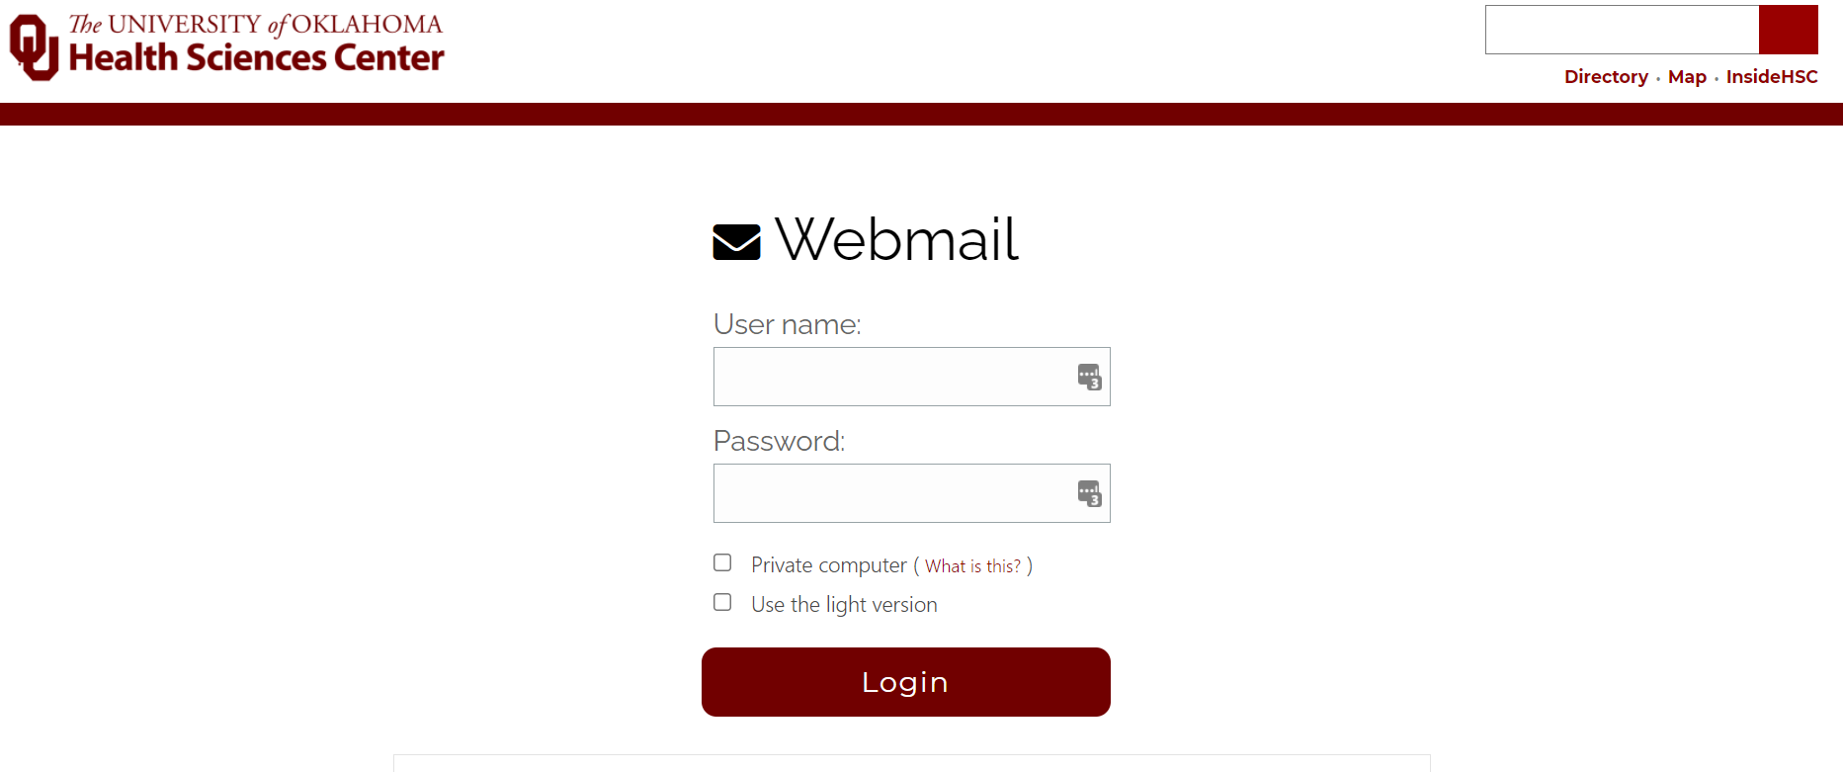

Slide 17
New Learning Management System!
Canvas.ou.edu

Slide 18


Slide 19


